Slide 1


22CS202 JAVA PROGRAMMING
R.M.D. ENGINEERING COLLEGE
UNIT-1
JAVA FUNDAMENTALS

Slide 2
UNIT 1-SYLLABUS
An Overview of Java - Data Types, Variables, and Arrays – Operators - Control Statements – Class Fundamentals – Declaring objects – Methods – Constructors – this keyword - Overloading methods - Overloading constructors - Access Control – Static – Final.

Slide 3
AN OVERVIEW OF JAVA
WHAT IS JAVA ??
Programming Language
High Level Language
Object –Oriented Language
Platform- A hardware or software environment in which programs runs.

Slide 4
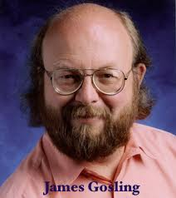
HISTORY OF JAVA
Initially developed by Sun Microsystems Incorporation.
TEAM NAME: GREEN TEAM
Led by JAMES GOSLING –in 1991
Initial Name : Oak
Why JAVA?
Java was originally designed for interactive television, but it was too advanced technology for the digital cable television industry at the time.
However, it was best suited for internet programming.
Later, Java technology was incorporated by Netscape.

Slide 5
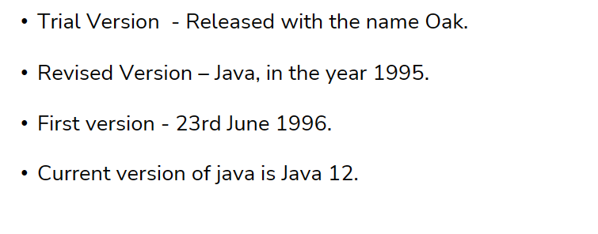
HISTORY OF JAVA
James Gosling, Mike Sheridan, and Patrick Naughton initiated the Java language project in June 1991. The small team of sun engineers called Green Team.
Initially it was designed for small, embedded systems in electronic appliances like set-top boxes.
Firstly, it was called "Greentalk" by James Gosling, and the file extension was .gt.
After that, it was called Oak and was developed as a part of the green project.
Why Java was named as "Oak"?
Oak is a symbol of strength and chosen as a national tree of many countries like the U.S.A., France, Germany, Romania, etc.
In 1995, Oak was renamed as "Java" because it was already a trademark by Oak Technologies.

Slide 6
HISTORY OF JAVA
Why Java Programming named "Java"?
The team gathered to choose a new name. The suggested words were "dynamic", "revolutionary", "Silk", "jolt", "DNA", etc. They wanted something that
reflected the essence of the technology: revolutionary, dynamic, lively, cool, unique, and easy to spell, and fun to say.
According to James Gosling, "Java was one of the top choices along with Silk". Since Java was so unique, most of the team members preferred Java than other names.
Java is an island in Indonesia where the first coffee was produced (called Java
coffee). It is a kind of espresso bean. Java name was chosen by James Gosling while having a cup of coffee nearby his office.

Slide 7
HISTORY OF JAVA
Notice that Java is just a name, not an acronym.
Initially developed by James Gosling at Sun Microsystems (which is now a subsidiary of Oracle Corporation) and released in 1995.
In 1995, Time magazine called Java one of the Ten Best Products of 1995.
JDK 1.0 was released on January 23, 1996.
After the first release of Java, there
have been many additional features added to the language. Now Java is being
used in Windows applications, Web applications, enterprise applications, mobile applications, cards, etc. Each new version adds new features in Java.

Slide 8
CHARACTERISTICS OF JAVA (JAVA BUZZWORDS)
1. Simple
❖ Easy to write and more readable and eye catching.
❖ Has concise set of features that makes it easy to learn and use.
❖ Most of the concepts are drew from C++ thus making Java learning simpler.
2. Secure
❖ Cannot harm other system thus making it secure.
❖ Provides a secure means of creating Internet applications.
❖ Provides secure way to access web applications.

Slide 9
CHARACTERISTICS OF JAVA
3. Portable
❖ Can execute in any environment for which there is a Java run-time system.
❖ (JVM)
❖ Can be run on any platform (Linux,Window,Mac)
❖ Can be transferred over world wide web (e.g. applets)
4. Object-oriented
❖ Java is object-oriented programming language.
❖ Like C++ java provides most of the object oriented features.
❖ Pure OOP Language. (while C++ is semi object oriented)

Slide 10
CHARACTERISTICS OF JAVA
5. Robust
It uses strong memory management.
❖ There are lack of pointers that avoids security problems.
❖ There is automatic garbage collection in java which runs on the Java Virtual Machine to get rid of objects which are not being used by a Java application anymore.
❖ There is exception handling and type checking mechanism in java. All these points makes java robust
6. Multi-Threaded
❖ A thread is like a separate program, executing concurrently. We can write Java programs that deal with many tasks at once by defining multiple threads.
❖ The main advantage of multi-threading is that it doesn't occupy memory for each thread. It shares a common memory area.
❖ Threads are important for multi-media, Web applications etc.

Slide 11
CHARACTERISTICS OF JAVA
7. Architecture-neutral
❖ Java is not tied to a specific machine or operating system architecture.
❖ Machine Independent i.e Java is independent of hardware.
❖ Interpreted
❖ Supports cross-platform code through the use of Java bytecode.
❖ Bytecode can be interpreted on any platform by JVM.
8. High performance
❖ Bytecodes are highly optimized.
❖ JVM can executed them much faster.

Slide 12
CHARACTERISTICS OF JAVA
9. Distributed
❖ Java was designed with the distributed environment.
❖ Java can transmit, run over internet.
10. Dynamic
❖ Java programs carry with them substantial amounts of run-time type information that is used to verify and resolve accesses to objects at run time.

Slide 13
JAVA ENVIRONMENT
Three Main Components:
JVM-Java Virtual Machine
JRE-Java Run Time Environment
JDK-Java Development Kit

Slide 14
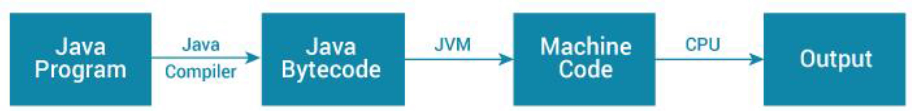
JVM(Java Virtual Machine)
JVM (Java Virtual Machine) is an abstract machine. It is a specification that provides runtime environment in which java bytecode can be executed .
When you run the Java program, Java compiler first compiles your Java code to bytecode.
Then, the JVM translates bytecode into native machine code.

Slide 15
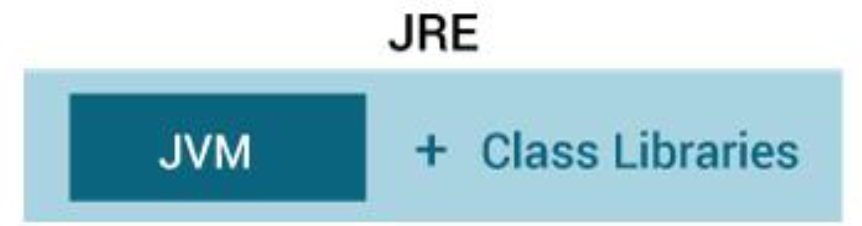
JRE-JAVA RUNTIME ENVIRONMENT
JRE (Java Runtime Environment) is a software package that provides Java class libraries, along with Java Virtual Machine (JVM), and other components to run applications written in Java programming. JRE is the superset of JVM.

Slide 16
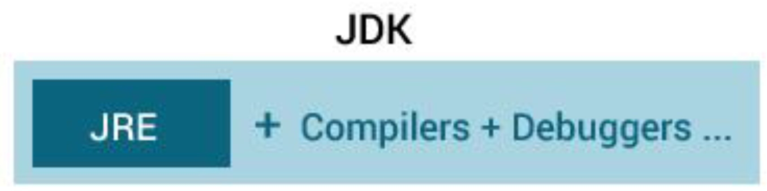
JDK (Java Development Kit)
JDK (Java Development Kit) is a software development kit to develop applications in Java. When you download JDK, JRE is also downloaded, and don't need to download it separately.
In addition to JRE, JDK also contains number of development tools (compilers, JavaDoc, Java Debugger etc).
JRE contains JVM and other Java class libraries.

Slide 17
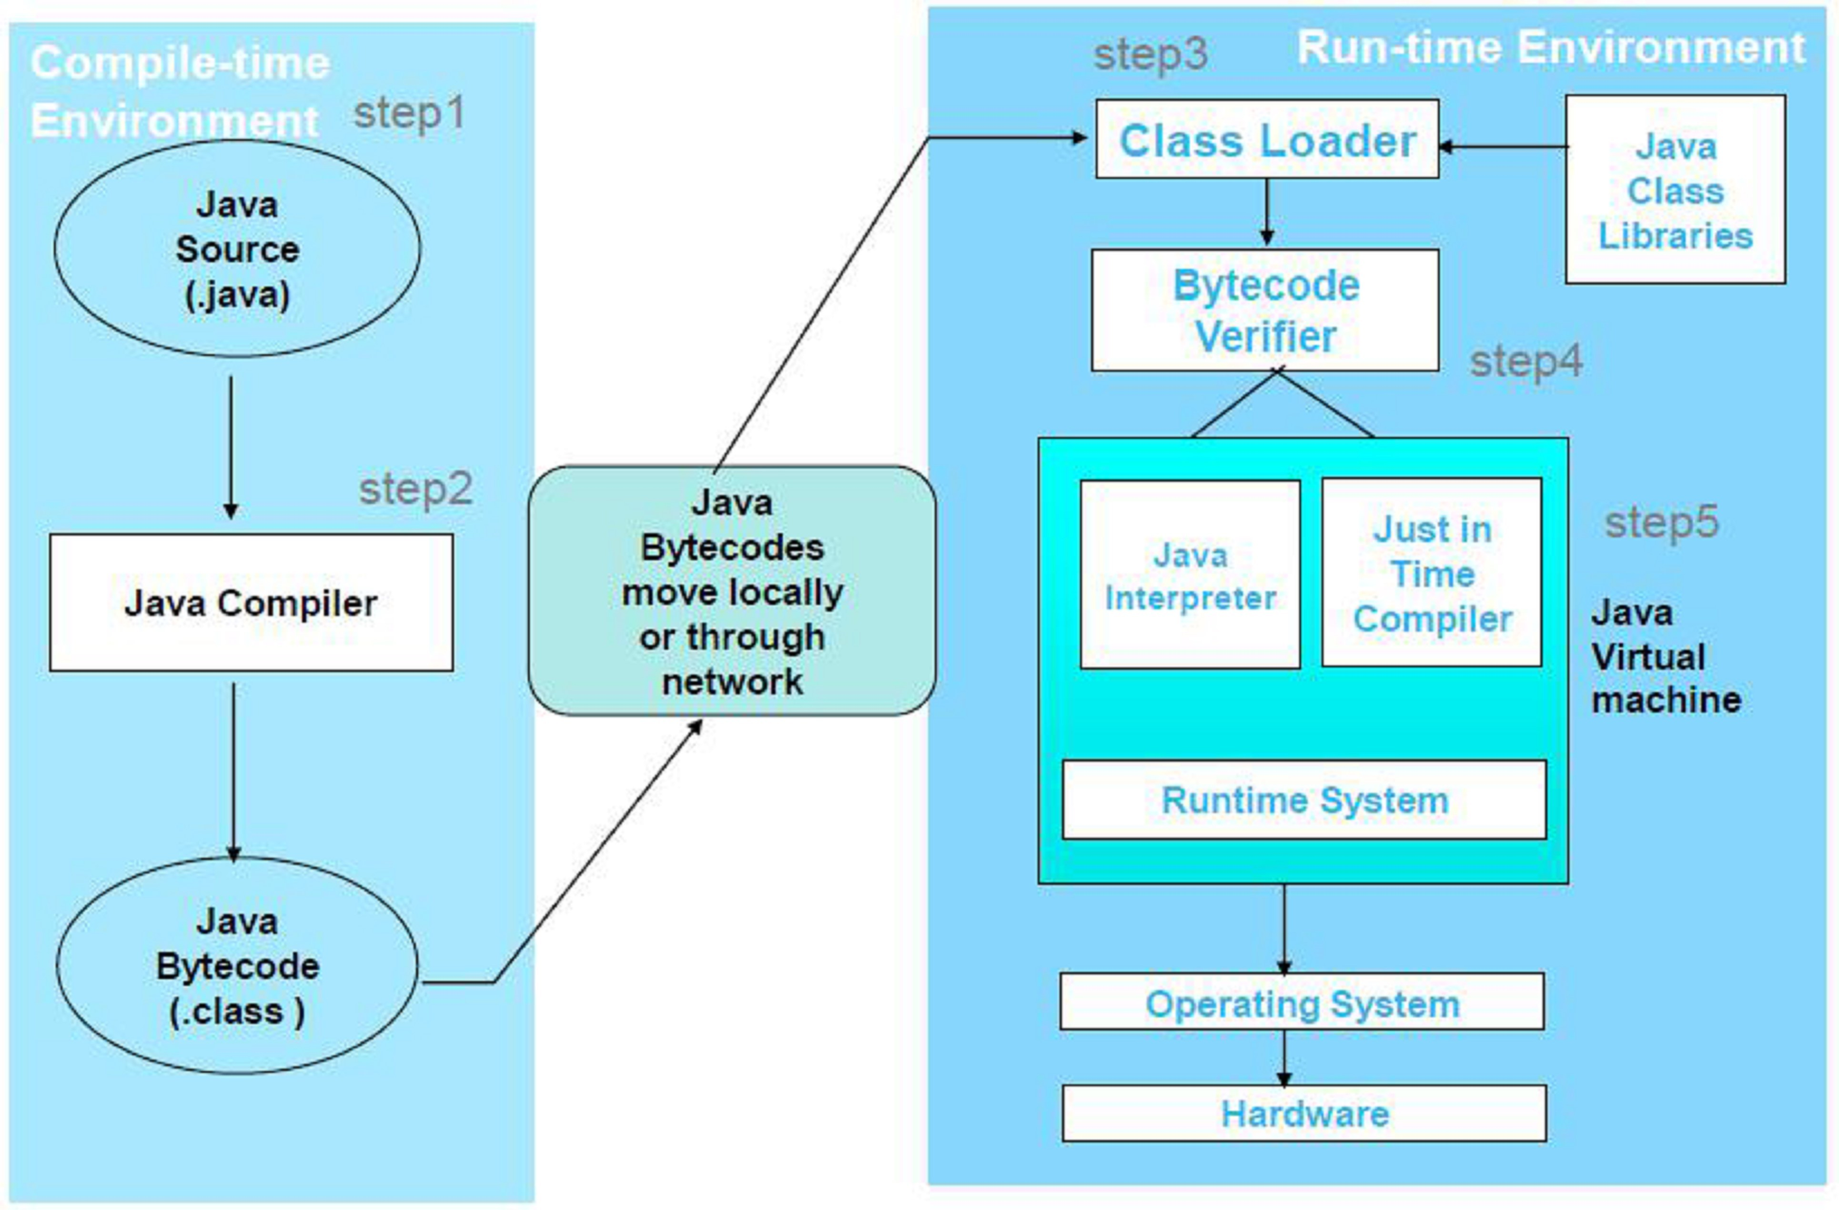
HOW ACTUALLY WORKS

Slide 18
HOW ACTUALLY WORKS: JAVA ENVIRONMENT/JAVA ARCHITECTURE
Java programs can typically be developed in five stages:
Edit: Use an editor to type the source code (Welcome java)
Compile: javac, the Java compiler is used to translate the source code to machine independent, bytecode Bytecodes are called class file
Loading: Class loader loads the bytecodes from class and other libraries file into
main memory
Verify: Verifier make sure, whether the bytecodes are valid and do not violate security restrictions
Execute: Java Virtual Machine (uses a combination of interpretation and just in time compilation to translate bytecodes into machine language Applications are
run on user's machine, i.e., executed by interpreter with java command (java Welcome)

Slide 19
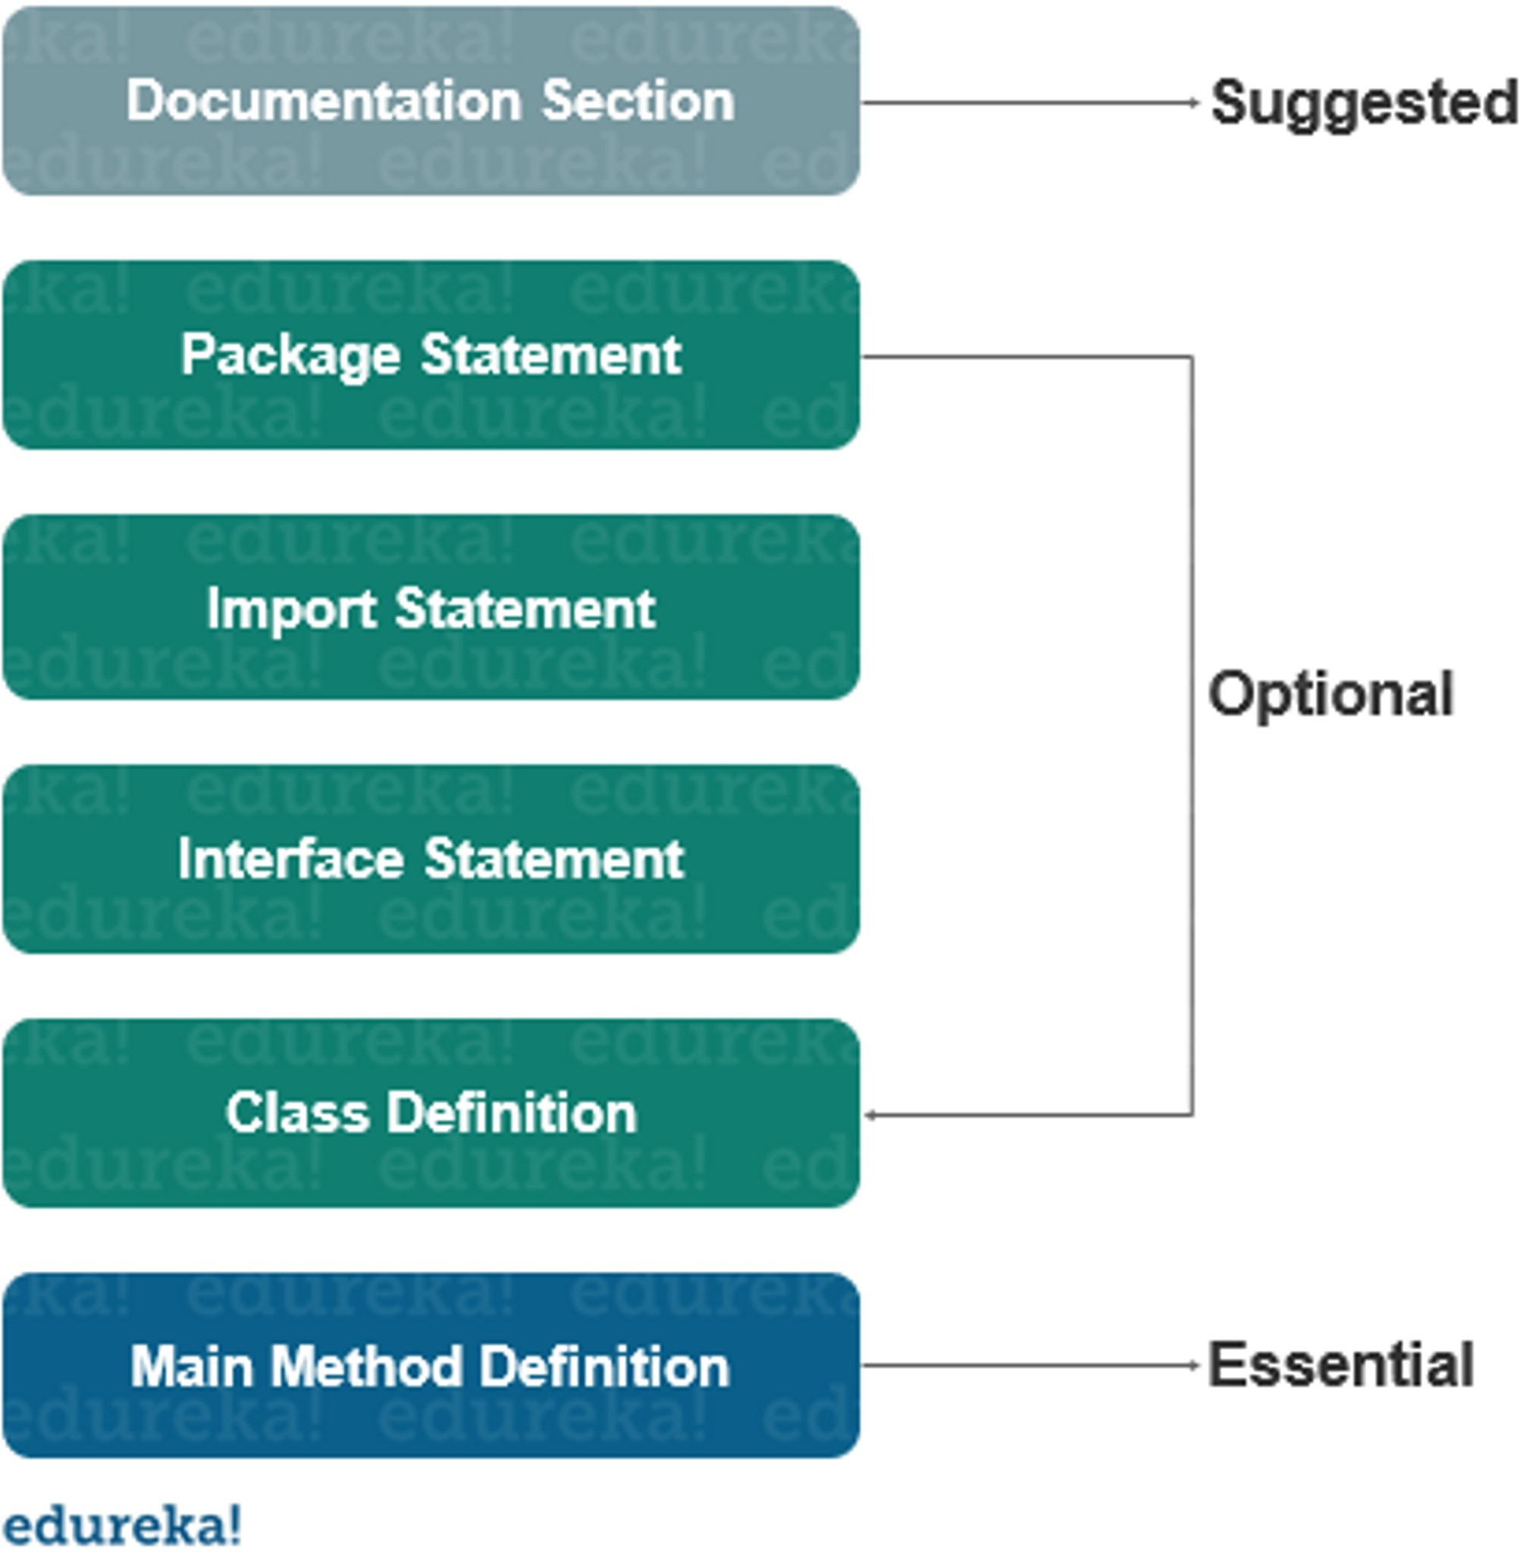
STRUCTURE OF JAVA PROGRAM

Slide 20
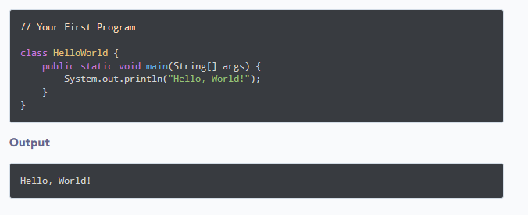
FIRST JAVA PROGRAM

Slide 21
PROGRAM EXPLANATION
class keyword is used to declare a class in java.
public keyword is an access modifier which represents visibility, it means it is visible to all.
static is a keyword, if we declare any method as static, it is known as static method. The core advantage of static method is that there is no need to create object to invoke the static method. The main method is executed by the JVM, so it doesn't require to create object to invoke the main method. So it saves memory.
void is the return type of the method, it means it doesn't return any value.
main represents the starting point of the program.
String[] args is used for command line argument.
System.out.println() is used print statement

Slide 22
EXECUTION OF JAVA PROGRAM
Java program can be executed using the following means
In command prompt
IDE
Online compilers

Slide 23
Command Prompt Execution
(Refer:https://www.youtube.com/watch?v=zBF1M8dTftk)
Download and Install JDK
(Refer: https://www.oracle.com/java/technologies/javase-downloads.html ) Installed in C: Program Files Java JDK
Save the Source Code in any working space Let Working Space be
D:\My Java Programs\Week1
Set the Path in Command Prompt
D:\My Java Programs\Week1> set path = “C:\Program Files\Java\JDK\Bin”
Compile the Source Code
D:\My Java Programs\Week1> javac Welcome.java
On successful Compilation Welcome.class (Byte Code) is created
Interpret / Execute the Class File (Byte Code)
D:\My Java Programs\Week1> java Welcome

Slide 24
STEPS FOR COMPILE AND RUN JAVA PROGRAM
First Save Java program with same as class name with .java extension. Example: Sum.java
Compile: javac Filename.java
Example : javac Sum.java
Run by: java Filename
Example: java sum

Slide 25
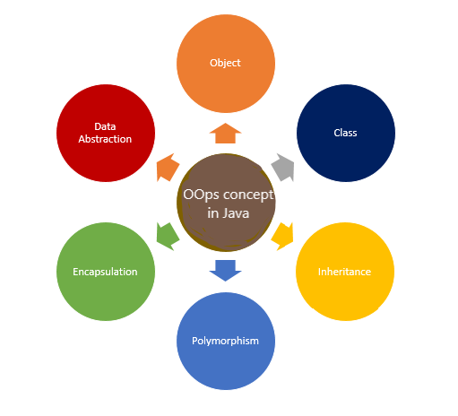
OBJECT ORIENTED PROGRAMMING
Object Oriented Programming is a paradigm with concepts such as class, object, data inheritance, polymorphism, etc.
Java-Object Oriented

Slide 26

CHARACTERISTICS OF OOP
OBJECT
Object means a real-world entity such as a pen, chair, table, computer, watch, etc.
A Object can be defined as an instance of a class.
Object of the class will have same properties and functions as defined in the class.

Slide 27
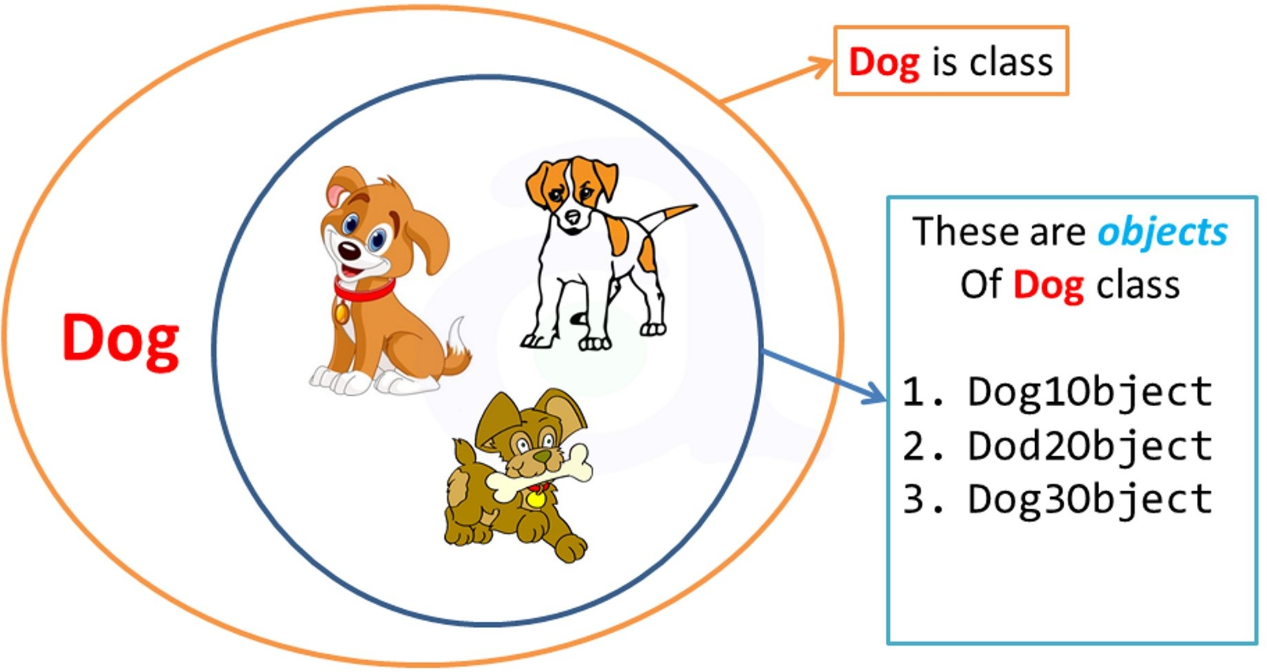
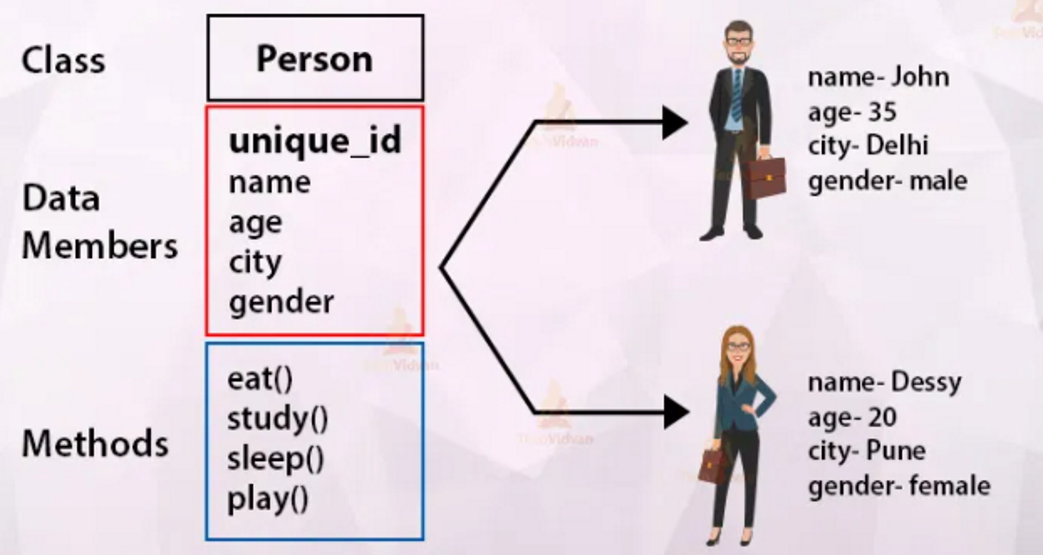
CLASS
Collection of objects is called class. It is a logical entity.
A class can also be defined as a blueprint from which you can create an individual object.
Example of Class and Object

Slide 28
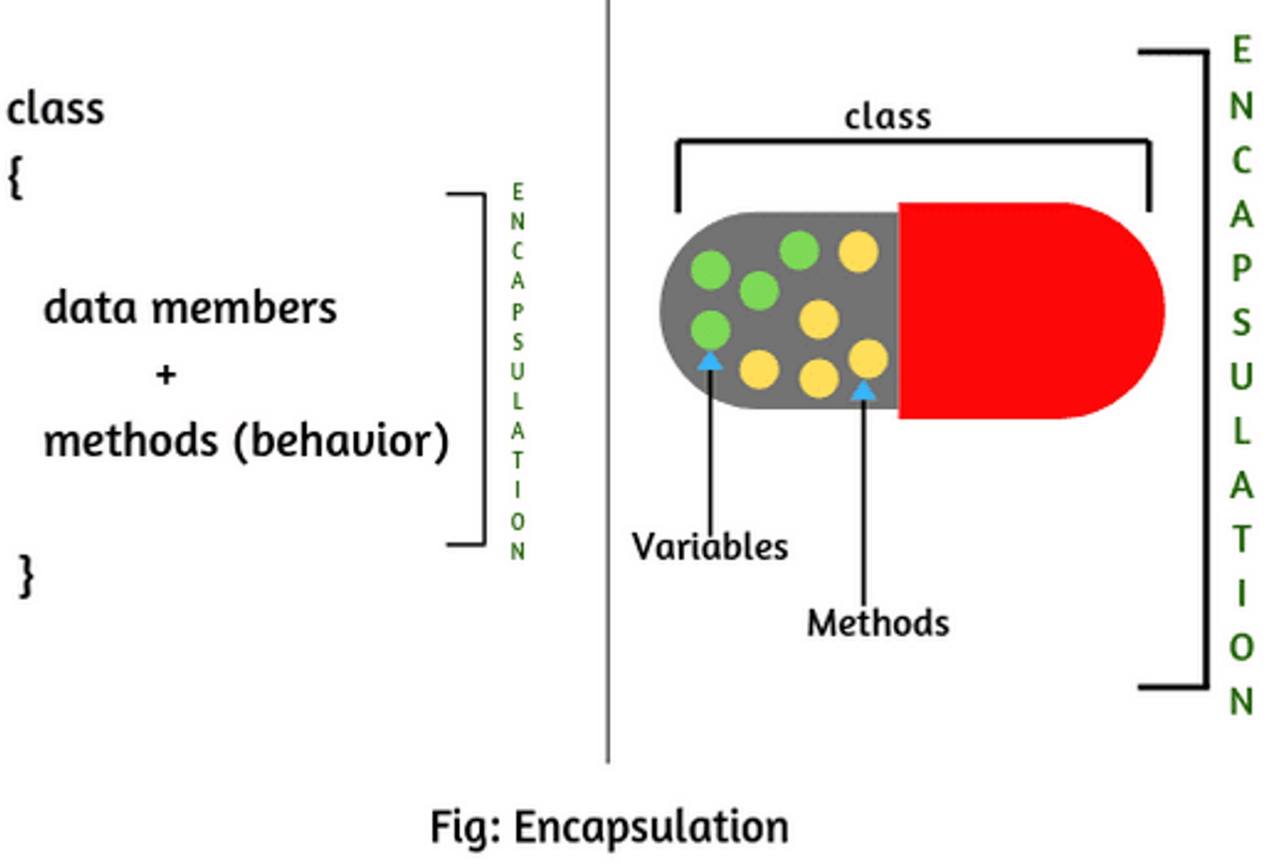
ABSTRACTION
It refers to the act of representing essential feature without including the background details.
It basically hides unnecessary details from the user.
ENCAPSULATION
The wrapping up of data and methods into a single unit.
Data is not accessible outside the class. This can be done by access specifiers.
Provides the security that keeps data and methods safe from inadvertent changes.
A java class is the example of encapsulation.

Slide 29
INHERITANCE
When one object (derived class) acquires all the properties and behavior's of parent object(base class), it is known as inheritance.
It provides code reusability.
POLYMORPHISM
Poly refers to ‘many’ and morph refers to ‘form’
The ability to take more than one form.
In Java, we use method overloading and method overriding to achieve polymorphism.
Types of Polymorphism
Compile Time Polymorphism (Method Overloading)
Run Time Polymorphism (Method Overriding)

Slide 30
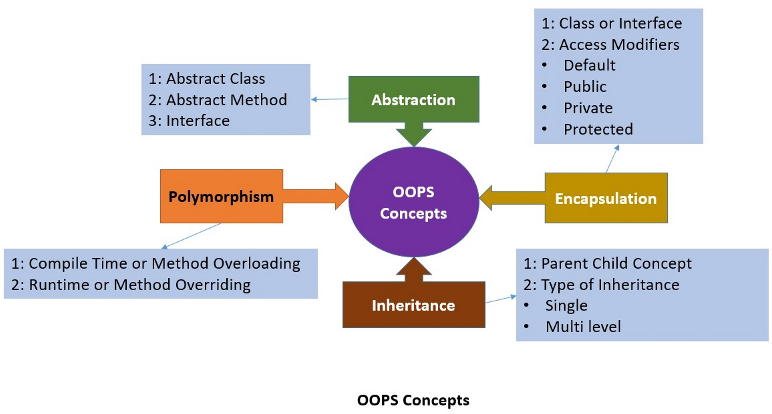
SUMMARY OF OOP

Slide 31
JAVA COMMENTS
The java comments are statements that are not executed by the compiler and interpreter. The comments can be used to provide information or explanation about the variable, method, class or any statement.
Types of Java Comments
Single Line Comment
The single line comment is used to comment only one line.
Syntax:
// This is single line comment
Multi Line Comment
The multi line comment is used to comment multiple lines of code.
Syntax:
/* This is
multi line comment
*/

Slide 32
DATA TYPES IN JAVA
Data Types in Java is based on the data type of a variable, the operating system allocates memory and decides what can be stored in the reserved memory.
Therefore, by assigning different data types to variables, you can store integers, decimals, or characters in these variables.
In java, there are two types of data types
primitive data types
non-primitive data types

Slide 33
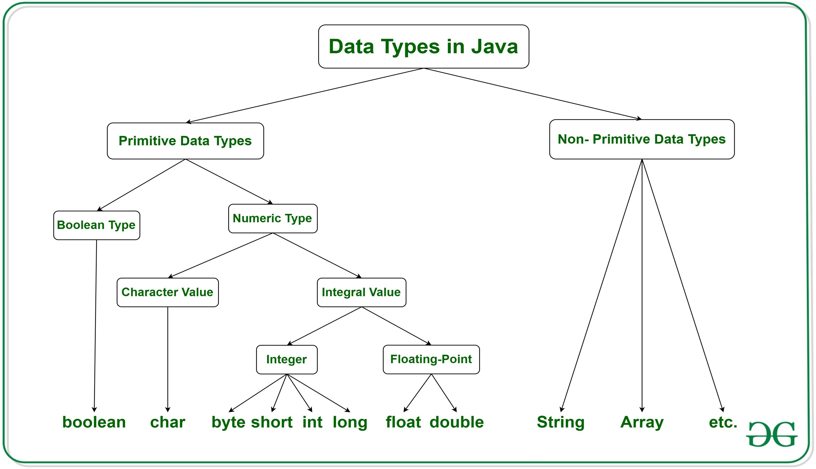
DATA TYPES IN JAVA

Slide 34
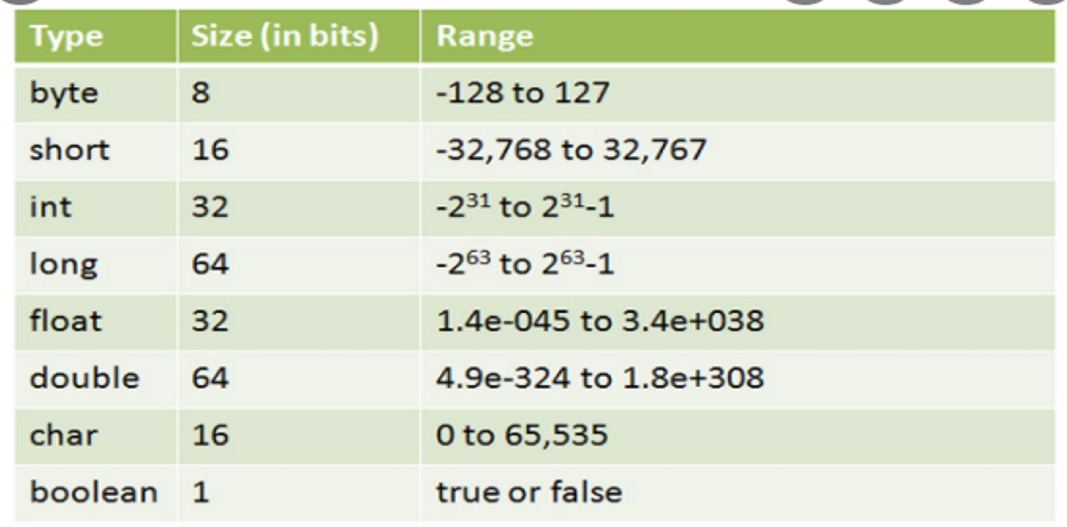
Data Type and its Range

Slide 35
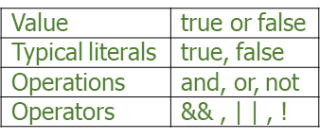
Boolean Data Type
The Boolean data type is used to store only two possible values: true and false.
This data type is used for simple flags that track true/false conditions.
The Boolean data type specifies one bit of information, but its "size" cannot be defined precisely.
Example:
Boolean one = false;
valid range of values, operators, and operations for boolean variables.

Slide 36
Byte Data Type
The byte data type is an example of a primitive data type. It is an 8-bit signed two's complement integer. Its value range lies between -128 to 127 (inclusive). Its minimum value is -128 and the maximum value is 127. Its default value is 0.
The byte data type is used to save memory in large arrays where memory savings is most required. It saves space because a byte is 4 times smaller than an integer. It can also be used in place of the "int" data type.
Example:
byte a = 10, byte b = -20;
Short Data Type
The short data type is a 16-bit signed two's complement integer. Its value range lies between -32,768 to 32,767 (inclusive). Its minimum value is -32,768 and its maximum value is 32,767. Its default value is 0.
The short data type can also be used to save memory just like the byte data type. A short data type is 2 times smaller than an integer.
Example:
short s = 10000, short r = -5000;

Slide 37
Int Data Type
The int data type is a 32-bit signed two's complement integer. Its value range lies between - 2,147,483,648 (-2^31) to 2,147,483,647 (2^31 -1) (inclusive). Its minimum value is - 2,147,483,648and maximum value is 2,147,483,647. Its default value is 0.
The int data type is generally used as a default data type for integral values unless there is no problem with memory.
Example:
int a = 100000, int b = -200000;
Long Data Type
The long data type is a 64-bit two's complement integer. Its value-range lies between -9,223,372,036,854,775,808(-2^63) to 9,223,372,036,854,775,807(2^63 -1)
(inclusive). Its minimum value is - 9,223,372,036,854,775,808and maximum value is 9,223,372,036,854,775,807.
Its default value is 0. The long data type is used when you need a range of values more than those provided by int.
Example:
long a = 100000L, long b = -200000L;

Slide 38
Float Data Type
The float data type is a single-precision 32-bit IEEE 754 floating point. Its value range is unlimited. It is recommended to use a float (instead of a double) if you need to save memory in large arrays of floating-point numbers. The float data type should never be used for precise values, such as currency. Its default value is 0.0F.
Example:
float f1 = 234.5f;
Double Data Type
The double data type is a double-precision 64-bit IEEE 754 floating point. Its value range is unlimited. The double data type is generally used for decimal values just like float. The double data type also should never be used for precise values, such as currency. Its default value is 0.0d.
Example:
double d1 = 12.3;
Char Data Type
The char data type is a single 16-bit Unicode character. Its value range lies between '\u0000' (or 0) to '\uffff' (or 65,535 inclusive). The char data type is used to store characters.
Example:
char letterA = 'A';

Slide 39
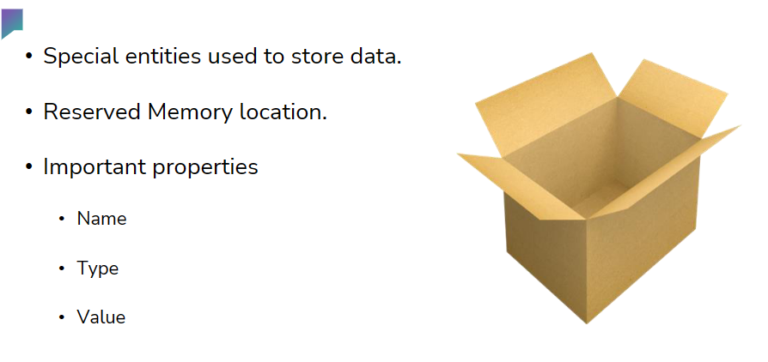
VARIABLES
Java is a statically typed programming language. It means, all variables must be declared before its use. Java is also a strictly typed language.
A variable is a container that holds the value while the Java program is executed.
A variable is assigned with a data type.
Variable is a name of a memory location.
There are three types of variables in java: local, instance, and static.

Slide 40
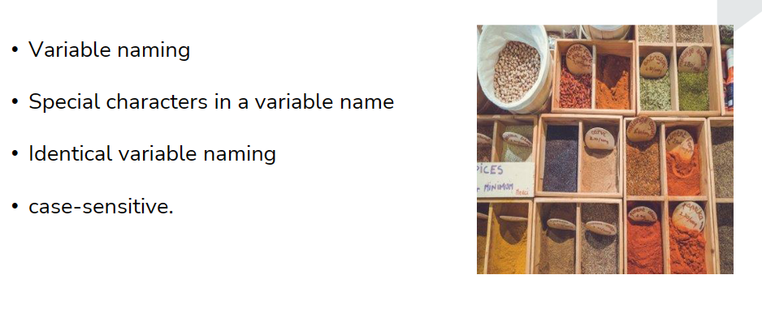
VARIABLE-NAME
Variable Names:
Variable names are case sensitive
A variable's name can be any legal identifier an unlimited length sequence of Unicode letters and digits, beginning with a letter, the dollar sign or the underscore character
Subsequent characters may be letters, digits, dollar signs, or underscore characters
White space is not permitted
keyword or reserved word should not be used as variable names
If the name chosen consists of only one word, spell that word in all lowercase letters. If it consists of more than one word, capitalize the first letter of each subsequent word
Example gearRatio and currentGear
If variable stores a constant value, such as static final int NUM_GEARS 6 the convention changes slightly, capitalizing every letter and separating subsequent words with the underscore character

Slide 41
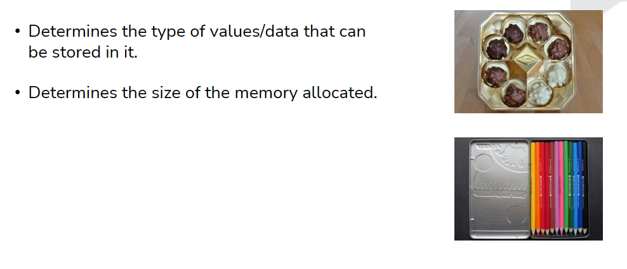
VARIABLE-TYPE

Slide 42
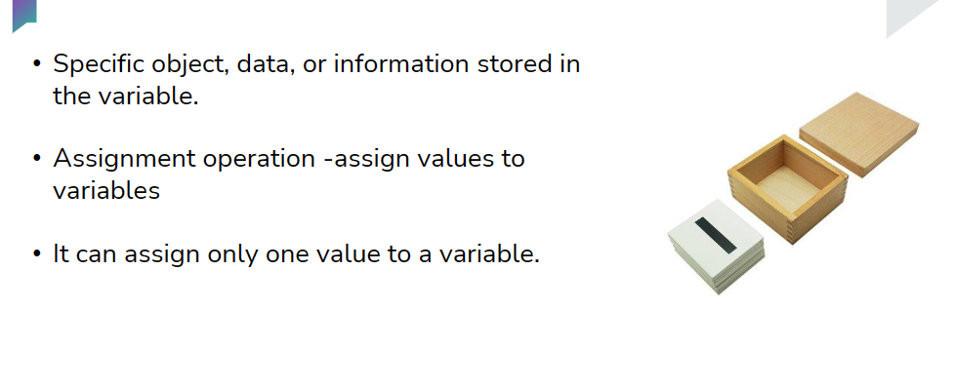
VARIABLE-VALUES

Slide 43

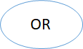

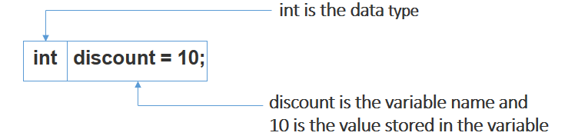
VARIABLE DECLARATION
Field / Variable declarations are composed of three components, in order:
Zero or more modifiers, such as public or private.
The field's type.
The field's name.

Slide 44
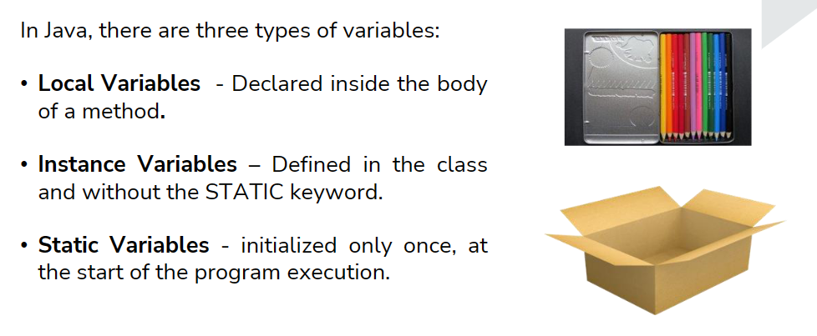
TYPES OF VARIABLES IN JAVA

Slide 45
Example
public class VariableDemo {
int data = 50; // instance variable
// static variable
static final int MAXIMUM_DATA = 100;
void method() {
int currentData = 90; // local variable
}
}// end of class

Slide 46
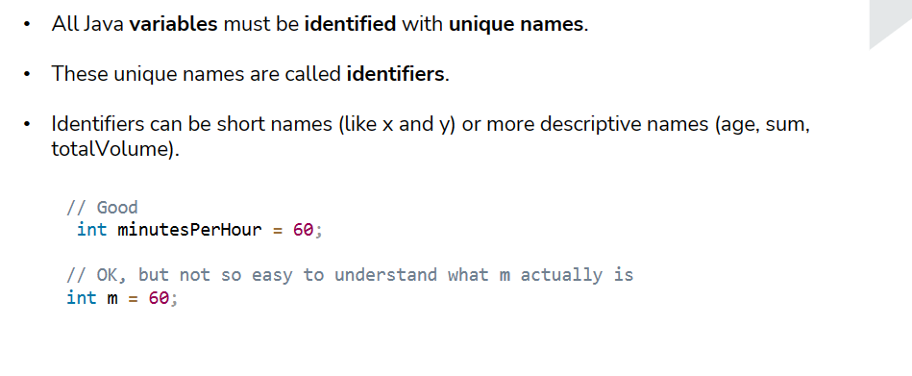
Java-Identifiers

Slide 47
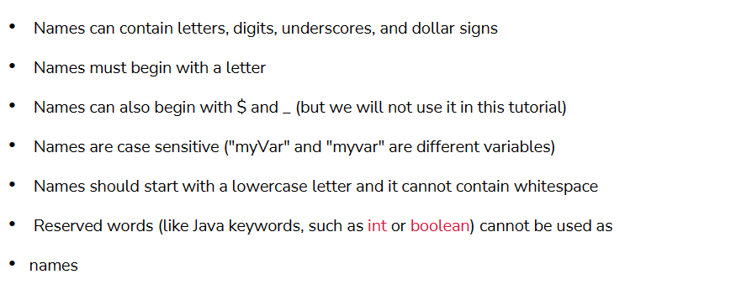
Rules for Naming an Identifiers

Slide 48
Examples for Identifiers
VALID IDENTIFIERS
INVALID IDENTIFIERS
Examples:
TestVariable
testvariable
a
i
Test_Variable
_testvariable
$testvariable
sum_of_array
TESTVARIABLE
jtp123
Examples:
Test Variable (We can not include a space in an identifier)
123hello (The identifier should not begin with numbers)
hello+word ( The plus (+) symbol cannot be used)
a-student ( Hyphen symbol is not allowed)
hello_&_world (ampersand symbol is not allowed)
Java'tpoint (we can not use an apostrophe symbol in an identifier)

Slide 49
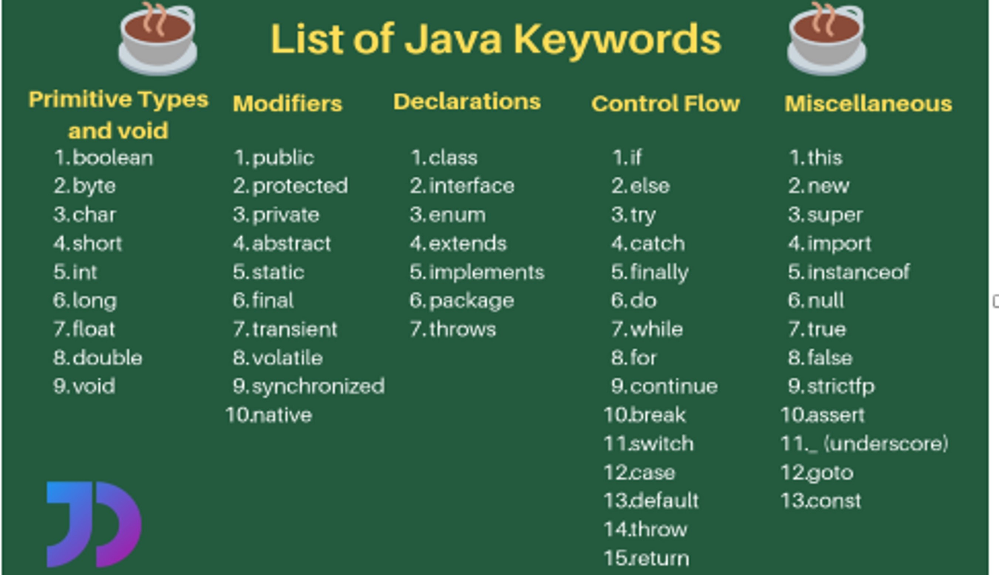
JAVA KEYWORDS
Java keywords are also known as reserved words.
Keywords are particular words that act as a key to a code. These are predefined words by Java so they cannot be used as a variable or object name or class name.

Slide 50
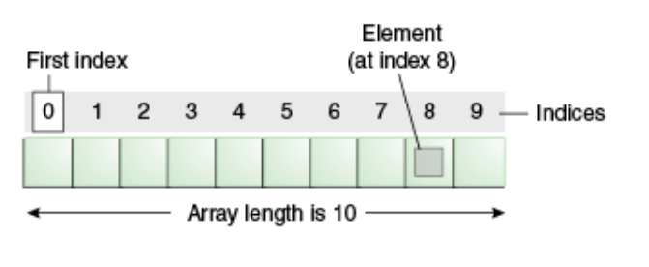
ARRAY IN JAVA
Java array is an object which contains elements of a similar data type. Additionally, The elements of an array are stored in a contiguous memory location. It is a data structure where we store similar elements. We can store only a fixed set of elements in a Java array.
Array in Java is index-based, the first element of the array is stored at the 0th index, 2nd element is stored on 1st index and so on.

Slide 51
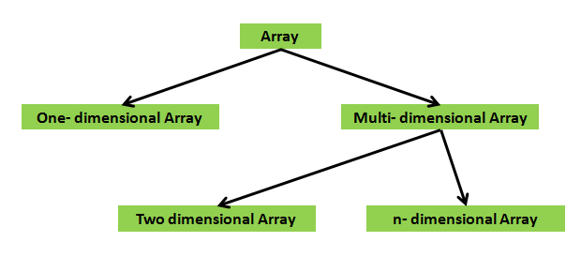
TYPES OF ARRAYS IN JAVA
There are two types of arrays.
One Dimensional Array
Multi-Dimensional Array

Slide 52
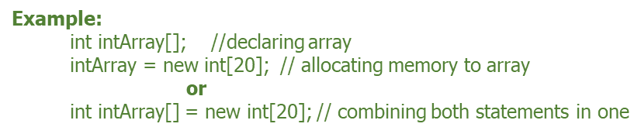
One Dimensional Array in Java
Syntax to Declare an Array in Java
dataType[] arr;
dataType []arr;
dataType arr[];
Instantiation of an Array in Java
arrayRefVar=new datatype[size];

Slide 53
Java Program to illustrate how to declare, instantiate, initialize and traverse the Java array.
//Program
class Testarray
{
public static void main(String args[])
{
int a[]=new int[5]; //declaration and instantiation
a[0]=10; //initialization
a[1]=20;
a[2]=70;
a[3]=40;
a[4]=50;
//traversing array
for(int i=0;i<a.length;i++) //length is the property of array
System.out.println(a[i]);
}
}
OUTPUT
10
20
70
40
50

Slide 54
TWO-DIMENSIONAL ARRAY IN JAVA
Data is stored in a row and column-based index (also known as matrix form).
SYNTAX
dataType[][] arrayRefVar;
(or)
dataType [][]arrayRefVar;
(or)
dataType arrayRefVar[][];
Example to instantiate Multidimensional Array in Java
int[][] arr=new int[3][3]; //3 row and 3 column

Slide 55
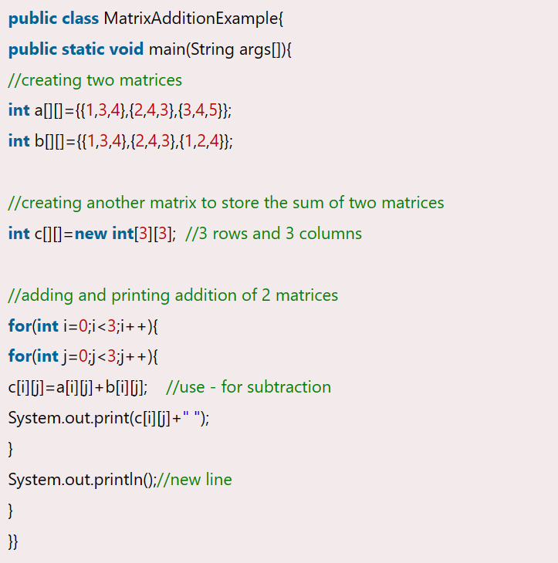
Example: Matrix Addition

Slide 56
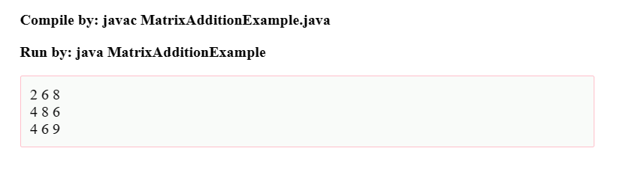
OUTPUT

Slide 57
ADVANTAGES & DISADVANTAGES
ADVANTAGES
Code Optimization: It makes the code optimized, we can retrieve or sort the data efficiently.
Random access: We can get any data located at an index position.
DISADVANTAGES
Size Limit: We can store only the fixed size of elements in the array. It doesn't grow its size at runtime. To solve this problem, collection framework is used in Java which grows automatically.

Slide 58
Operators

Slide 59
Operators are the symbols used to perform specific operations. Various operators can be used for different purposes.
The operators are categorized as:
Unary
Arithmetic
Relational
Logical
Ternary
Assignment
Bitwise
Unary Operators
Unary operators act upon only one operand and perform operations such as increment, decrement, negating an expression, or inverting a Boolean value.

Slide 60
Operator | Name | Description
++ | Post increment | Increments the value after use
 | Pre increment | Increments the value before use
-- | Post increment | decrements the value after use
 | Pre increment | decrements the value before use
~ | Bitwise complement | Flips bits of the value
! | Logical negation | Inverts the value of a Boolean

Slide 61
Unary Operator Example: ++ and --
public class OperatorExample
{
public static void main(String args[])
{
int x=10;
System.out.println(x++);
System.out.println(++x);
System.out.println(x--);
System.out.println(--x);
}
}
Output:
10
12
12
10

Slide 62
Example: ~ and !
public class OperatorExample
{
public static void main(String args[])
{
int a=10;
int b=-10;
boolean c=true;
boolean d=false;
System.out.println(~a);
System.out.println(~b);
System.out.println(!c);
System.out.println(!d);
} }
Output:
-11
9
false
true

Slide 63
Example
class Welcome
{
public static void main(String args[])
{
int numOne = 10; int numTwo = 5;
boolean isTrue = true;
System.out.println(numOne++ + " " + ++numOne); //Output will be 10 12
System.out.println(numTwo-- + " " + --numTwo); //Output will be 5 3 System.out.println(!isTrue + " " + ~numOne); //Output will be false -13
}
}

Slide 64
Arithmetic Operators Arithmetic operators are used to perform basic mathematical operations like addition, subtraction, multiplication, and division.
Operator | Description
+ | Additive operator (also used for string concatenation)
- | Subtractive operator
* | Multiplication operator
/ | Division operator
% | Modulus operator

Slide 65
Example
class Welcome
{
public static void main(String args[])
{
int numOne = 10;
int numTwo = 5;
System.out.println(numOne + numTwo); //Output will be 15 System.out.println(numOne - numTwo); //Output will be 5
System.out.println(numOne * numTwo); //Output will be 50 System.out.println(numOne / numTwo); //Output will be 2
System.out.println(numOne % numTwo); //Output will be 0
}
}

Slide 66
Relational operators
Relational operators are used to compare two values. The result of all the relational operations is either true or false.
Operator | Description
== | Equal to
< | Less than
> | Greater than
<= | Less than or equal to
>= | Greater than or equal to
!= | Not equal to

Slide 67
Example
class Welcome
{
public static void main(String args[])
{
int numOne = 10;
int numTwo = 5;
System.out.println(numOne > numTwo);
}
}
Output:
true

Slide 68
Logical Operators
Logical operators are used to combine two or more relational expressions or to negate the result of a relational expression.
Assume A and B to be two relational expressions. The below tables show the result for various logical operators based on the value of expressions, A and B.
Operator | Name | Description
&& | AND | The result will be true only if both expressions are true
|| | OR | The result will be true if any one of the expressions is true
! | NOT | The result will be false if the expression is true and vice versa
A | B | A&&B | A||B
True | True | True | True
True | False | False | True
False | True | False | True
False | False | False | False
A | !A
True | False
False | True

Slide 69
Ternary Operator
The ternary operator is used as a single-line replacement for if-then-else statements and acts upon three operands.
Syntax:
<condition> ? <value if condition is true> : < value if condition is false>
Example
class Welcome
{
public static void main(String args[])
{
int numOne = 10;
int numTwo = 5;
int min = (numOne < numTwo) ? numOne : numTwo; System.out.println(min); //Output will be 5
}
}
Here, first the condition (numOne < numTwo) is evaluated. The result is false and hence, min will be assigned the value numTwo.

Slide 70
Assignment Operator
The assignment operator is used to assign the value on the right-hand side to the variable on the left-hand side of the operator.
Operator | Description
= | Assigns the value on the right to the variable on the left
+= | Adds the current value of the variable on the left to the value on the right and then assigns the result to the variable on the left
-= | Subtracts the value of the variable on the right from the current value of the variable on left and then assigns the result to the variable on the left
*= | Multiplies the current value of the variable on left to the value on the right and then assigns the result to the variable on the left
/= | Divides the current value of the variable on left by the value on the right and then assign the result to the variable on the left

Slide 71
Example
import java.io.*;
class Welcome
{
public static void main(String args[])
{
int numOne = 10; //The value 10 is assigned to numOne System.out.println(numOne); //Output will be 10
numOne + = 5;
System.out.println(numOne); //Output will be 15 numOne - = 5;
System.out.println(numOne); //Output will be 10 numOne * = 5;
System.out.println(numOne); //Output will be 50 numOne / = 5;
System.out.println(numOne); //Output will be 10
}
}

Slide 72
Bitwise Operators
Bitwise operators are used to perform manipulation of individual bits of a number. Let us understand how to convert a decimal number to a binary number and vice versa.
The decimal or the base 10 number system is used in everyday life but the binary number system is the basis for representing data in computing systems.
Steps to convert a decimal number to a binary number.
Step 1: Divide the decimal number by 2.
Step 2: Write the number on the right-hand side. This will be either 1 or 0
Step 3: Divide the result of the division again by 2 and write the remainder.
Step 4: Continue this process until the result of the division is 0.
Step 5: The first remainder that you received is the least significant bit and the last remainder is the most significant bit.

Slide 73
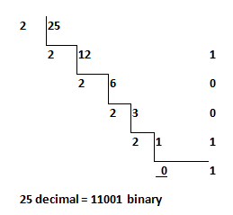
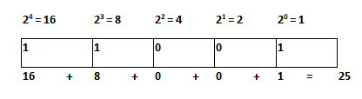
Steps to convert the binary number back to a decimal number.
The decimal number is equal to the sum of binary digits (dn) times their power of 2 (2n).
Let us take the example of 11001.
11001 = 1*2⁴+1*2³+0*2²+0*2¹+1*2⁰ = 16+8+0+0+1 = 25

Slide 74
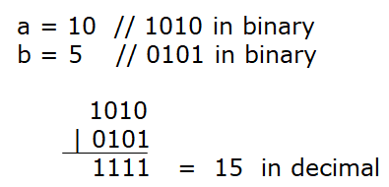
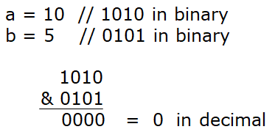
Bitwise OR (|)
It returns bit by bit OR of the input values. If either of the bits is 1, then it gives 1, else it gives 0.
E.g. - The output of 10 | 5 is 15.
Bitwise AND (&)
It returns bit by bit AND of the input values. If both the bits are 1, then it gives 1, else it gives 0.
E.g. - The output of 10 & 5 is 0.

Slide 75
Left shift operator (<<)
It takes two operators and left shifts the bits of the first operand. The second operand decides the number of places to shift. It fills 0 on voids left as a result.
E.g. - The output of 10<<1 is 20 if the numbers are stored in a 32-bit system.
10 is represented as 00000000 00000000 00000000 00001010.
After left shifting by 1 bit, the result becomes 00000000 00000000 00000000 000010100 which is 20.
The 0 that is highlighted is present because of the void. Similarly, the output of 10<<2 is 40.

Slide 76
Signed Right shift operator (>>)
It takes two operators and right shifts the bits of the first operand. The second operand decides the number of places to shift. It fills 0 on voids left as a result of the first operand being positive else it fills 1.
E.g. – An example of the positive number
The output of 10>>1 is 5.
10 is represented as 00000000 00000000 00000000 00001010.
After right shifting by 1 bit, the result becomes 00000000 00000000 00000000 00000101 which is 5.
Example of a negative number
The output of -10>>1 is -5.
-10 is represented as 11111111 11111111 11111111 11110110.
After right shifting by 1 bit, the result becomes 11111111 11111111 11111111 11111011 which is -5.

Slide 77
Unsigned Right shift operator (>>>)
It takes two operators and right shifts the bits of the first operand. The second operand decides the number of places to shift. It fills 0 on voids left as a result.
E.g. – An example a of a positive number
The output of 10>>>1 is 5.
10 is represented as 00000000 00000000 00000000 00001010.
After right shifting by 1 bit, the result becomes 00000000 00000000 00000000 00000101 which is 5.
Example of a negative number
The output of -10>>>1 is 214783643.
-10 is represented as 11111111 11111111 11111111 11110110.

Slide 78
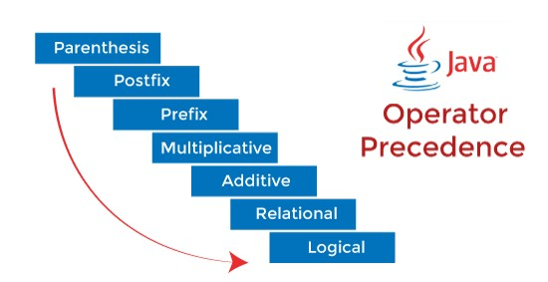
After right shifting by 1 bit, the result becomes 01111111 11111111 11111111 11111011 which is 214783643.
Operator Precedence
The operator precedence represents how two expressions are bound together. In an expression, it determines the grouping of operators with operands and decides how an expression will evaluate.
While solving an expression two things must be kept in mind the first is a precedence and the second is associativity.

Slide 79
Precedence | Operator | Type | Associativity
15 | () [] · | Parentheses Array subscript Member selection | Left to Right
14 | ++ -- | Unary post-increment Unary post-decrement | Right to left
13 | ++ -- + - ! ~ (type) | Unary pre-increment Unary pre-decrement Unary plus Unary minus Unary logical negation Unary bitwise complement Unary type cast | Right to left
12 | * / % | Multiplication Division Modulus | Left to right
11 | + - | Addition Subtraction | Left to right
10 | << >> >>> | Bitwise left shift Bitwise right shift with sign extension Bitwise right shift with zero extension | Left to right

Slide 80
Precedence | Operator | Type | Associativity
9 | < <= > >= instanceof | Relational less than Relational less than or equal Relational greater than Relational greater than or equal Type comparison (objects only) | Left to right
8 | == != | Relational is equal to Relational is not equal to | Left to right
7 | & | Bitwise AND | Left to right
6 | ^ | Bitwise exclusive OR | Left to right
5 | | | Bitwise inclusive OR | Left to right
4 | && | Logical AND | Left to right
3 | || | Logical OR | Left to right
2 | ? : | Ternary conditional | Right to left
1 | = += -= *= /= %= | Assignment Addition assignment Subtraction assignment Multiplication assignment Division assignment Modulus assignment | Right to left

Slide 81
Control Statements

Slide 82
Control Statements
Java compiler executes the code from top to bottom. The statements in the code are executed according to the order in which they appear.
However, Java provides statements that can be used to control the flow of Java code. Such statements are called control flow statements.
It is one of the fundamental features of Java, which provides a smooth flow of program.
Three types of control flow statements.
Decision Making statements
if statements
Simple if statement
if-else statement
if-else-if ladder
Nested if-statement
switch statement

Slide 83
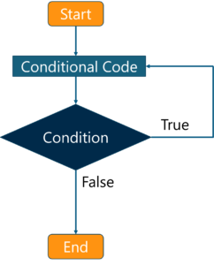
Loop statements
do while loop
while loop
for loop
for-each loop
Jump statements
break statement
continue statement

Slide 84
Decision Making statements
Decision-making statements decide which statement to execute and when.
It evaluate the Boolean expression and control the program flow depending upon the result of the condition provided.
If Statements:
1. If Statement:
The if statement is used to decide whether a particular block of code will be executed or not based on a certain condition. If the condition is true, then the code is executed otherwise not.
Syntax:
if(condition)
{
// block of code to be executed if the condition is true
}

Slide 85
Example Program
public class Student
{
public static void main(String[] args)
{
int x = 10;
int y = 12;
if(x+y > 20)
{
System.out.println("x + y is greater than 20");
}
}
}
Output:
x + y is greater than 20

Slide 86
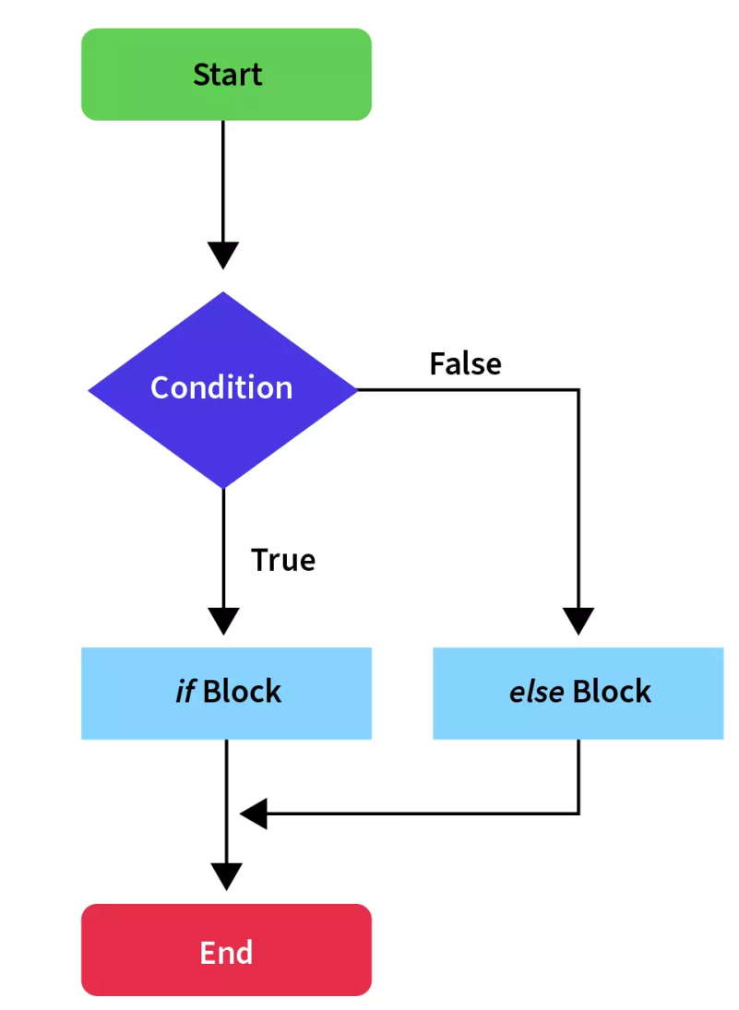
2) if-else statement
If the condition specified is true, the if block is executed. Otherwise, the else block is executed.
Syntax:
if(condition) {
statement 1; //executes when condition is true
}
else{
statement 2; //executes when condition is false
}

Slide 87
Example Program:
public class Student
{
public static void main(String[] args)
{
int x = 10;
int y = 12;
if(x+y < 10)
{
System.out.println("x + y is less than 10");
}
else
{
System.out.println("x + y is greater than 20");
}
}
}
Output:
x + y is greater than 20

Slide 88
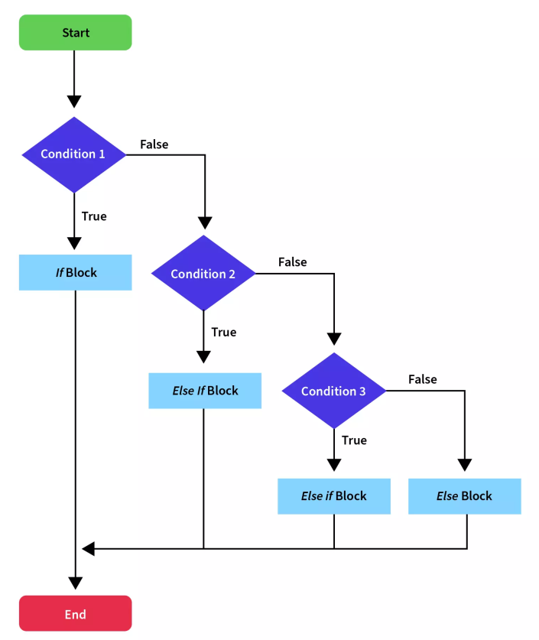
3) if-else-if ladder:
The if statement is followed by multiple else-if blocks. We can create a decision tree by using these control statements in Java in which the block where the condition is true is executed and the rest of the ladder is ignored and not executed.
If none of the conditions is true, the last else block is executed, if present.
Syntax
if(condition 1)
{
statement 1; //executes when condition 1 is true
}
else if(condition 2)
{
statement 2; //executes when condition 2 is true
}
else
{
statement 2; //executes when all the conditions are false
}

Slide 89
Example Program:
public class Student
{
public static void main(String[] args)
{
String city = "Delhi";
if(city == "Meerut")
{
System.out.println("city is meerut");
}
else if (city == "Noida")
{
System.out.println("city is noida");
}
else if(city == "Agra")
{
System.out.println("city is agra");
}
else
{
System.out.println(city);
} } }
Output:
Delhi

Slide 90
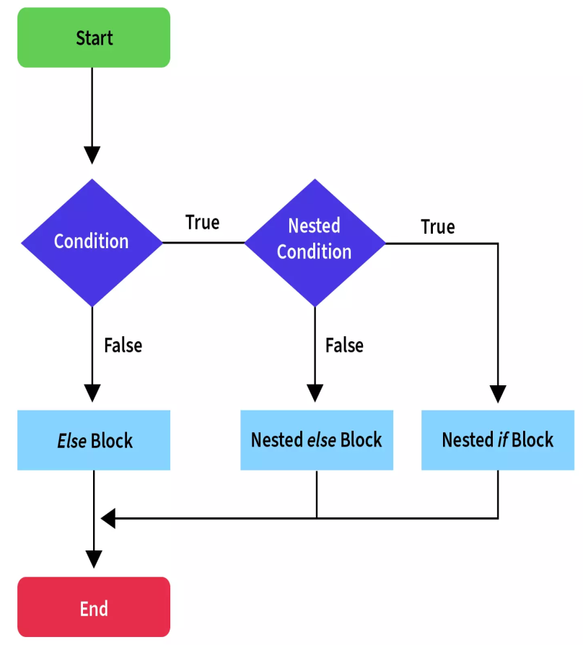
4. Nested if-statement
Java allows us to nest control statements within control statements. Nested control statements mean an if-else statement inside other if or else blocks. It is similar to an if-else statement but they are defined inside another if-else statement.
Syntax:
if(condition 1)
{
statement 1; //executes when condition 1 is true
if(condition 2)
{
statement 2; //executes when condition 2 is true
}
else{
statement 2; //executes when condition 2 is false
}
}

Slide 91
import java.io.*;
public class Student {
public static void main(String[] args) {
String address = "Delhi, India";
if(address.endsWith("India")) {
if(address.contains("Meerut")) {
System.out.println("Your city is Meerut");
}else if(address.contains("Noida")) {
System.out.println("Your city is Noida");
}else {
System.out.println(address.split(",")[0]);
}
}else {
System.out.println("You are not living in India");
} } }
Output:
Delhi

Slide 92
Switch Statements
Switch Statements are similar to if-else-if statements. The switch statement contains multiple blocks of code called cases and a single case is executed based on the variable which is being switched.
The switch statement is easier to use instead of if-else-if statements. It also enhances the readability of the program.
Notes to remember
Cases cannot be duplicate
Default statement is executed when any of the case doesn't match the value of expression. It is optional.
Break statement terminates the switch block when the condition is satisfied. It is optional, if not used, next case is executed.
While using switch statements, we must notice that the case expression will be of the same type as the variable. However, it will also be a constant value.

Slide 93
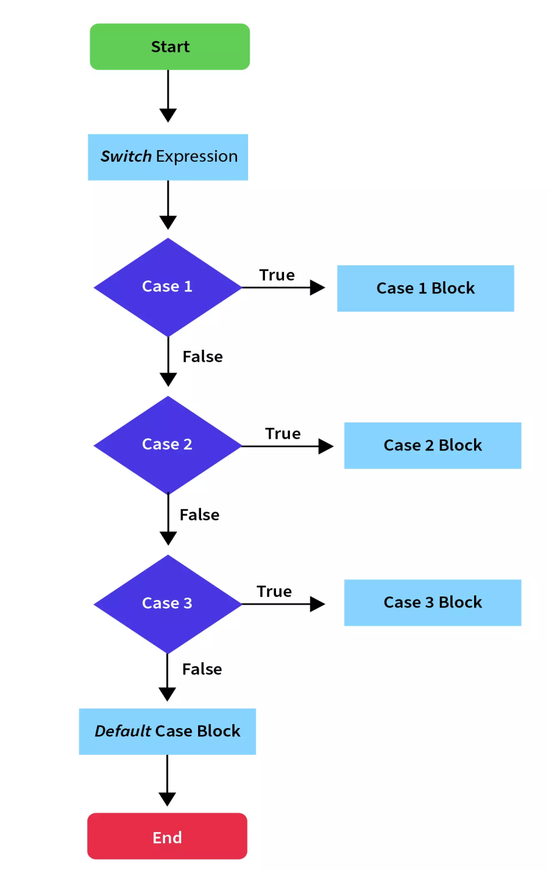
Syntax:
switch (expression)
{
case value1:
//code block of case with value1
break;
case value2:
//code block of case with value2
break;
.
.
case valueN:
//code block of case with valueN
break;
default:
//code block of default value
}

Slide 94
Example Program:
import java.io.*;
public class Sample {
public static void main(String[] args) {
int weekday = Integer.parseInt(args[0]);
switch (weekday) {
case 1:
System.out.println("Sunday");
break;
case 2:
System.out.println("Monday");
break;
case 3:
System.out.println("Tuesday");
break;
case 4:
System.out.println("Wednesday");
break;
case 5:
System.out.println("Thursday");
break;
case 6:
System.out.println("Friday");
break;
case 7:
System.out.println("Saturday");
break;
default:
System.out.println("Invalid day");
}
}
}
Output:
If args[0] is 5 then the ouput is
Thursday

Slide 95
Loop statements
In programming, sometimes we need to execute the block of code repeatedly while some condition evaluates to true.
However, loop statements are used to execute the set of instructions in a repeated order. The execution of the set of instructions depends upon a particular condition.
In Java, we have three types of loops that execute similarly. However, there are differences in their syntax and condition checking time.
for loop
while loop
do-while loop

Slide 96
while Loop
It’s a entry controlled loop, the condition in the while loop is evaluated, and if the condition is true, the code within the block is executed. This repeats until the condition becomes false
Syntax:
while(condition)
{
Body of the loop
}
false
Boolean Condition
true
Body of the loop

Slide 97
Example Program:
import java.io.*;
public class Sample {
public static void main(String[] args) {
int i = 0;
while (i < 5) {
System.out.println("i: " + i);
i = i + 1;
}
}}
Output:
i: 0
i: 1
i: 2
i: 3
i: 4

Slide 98
do.. while Loop
It’s a exit controlled loop, the body of the loop gets executed first followed by checking the condition. Continues with the body if the condition is true, else loops gets terminated.
Syntax
do
{
Body of the loop
} while(boolean expression);
Body of the loop
false
Boolean Condition
true

Slide 99
Example Program:
import java.io.*;
public class Sample {
public static void main(String[] args) {
int i = 5;
do {
System.out.println("i: " + i);
i = i + 1;
} while (i < 5);
}
}
Output:
i: 5

Slide 100
for Loop
The for loop initialize the value before the first step. Then checking the condition against the current value of variable and execute the loop statement and then perform the step taken for each execution of loop body.
For-loops are also typically used when the number of iterations is known before entering the loop.
Syntax:
for(initialization; condition; increment/decrement)
{
Body of the loop
}

Slide 101
Example Program:
import java.io.*;
public class Sample
{
public static void main(String[] args)
{
for (int i = 1; i <= 5; i++)
{
System.out.println("i: " + i);
}
}
}
Output:
i: 1
i: 2
i: 3
i: 4
i: 5

Slide 102
Enhanced For Loop or For Each Loop
Enhanced for loop used along with a collection of data.
Syntax:
for(declaration : expression) {
Body of loop
}
Example Program:
public class Sample
{
public static void main(String[] args)
{
int[] numbers = { 10, 20, 30, 40, 50 };
for (int i : numbers)
{
System.out.println("i: " + i);
} } }
Output:
i: 10
i: 20
i: 30
i: 40
i: 50

Slide 103
Jump/Branching Statements
Jump statements are used to transfer the control of the program to the specific statements. In other words, jump statements transfer the execution control to the other part of the program. There are two types of jump statements in Java, i.e., break and continue.
1. Break Statement
While the execution of program, the break statement will terminate the iteration or switch case block.
When a break statement is encountered in a loop, the loop is exited and the program continues with the statements immediately following the loop.
When the loops are nested, the break will only terminate the corresponding loop body.

Slide 104
Example Program
import java.io.*;
public class Sample
{
public static void main(String[] args)
{
for (int i = 1; i <= 5; i++)
{
if (i == 2)
break;
System.out.println("i: " + i);
}
}}
Output:
i: 1

Slide 105
continue Statement
The continue statement skips the current iteration of a loop.
In while and do loops, continue causes the control to go directly to the test-condition and then continue the iteration process.
In case of for loop, the increment section of the loop is executed before the test-condition is evaluated.
Example Program
import java.io.*;
public class Sample
{
public static void main(String[] args)
{
int[] numbers = { 1, 2, 3, 4, 5 };
for (int i : numbers)
{
if (i == 3)
{
continue;
}
System.out.println("i: " + i);
} }}
Output:
i: 1
i: 2
i: 4
i: 5

Slide 106
Class Fundamentals

Slide 107
Class in Java
A class is a group of objects which have common properties. It is a template or blueprint from which objects are created. It is a logical entity. It cannot be physical.
A class in Java can contain:
Fields / Variable
Methods
Constructors
Blocks
Nested class and interface
Syntax to declare a class:
class <class_name>
{
field / variable; method;
}
Example
import java.io.*;
class Sample
{
int a,b; //variable declaration
public:
void get(); //method1
void display(); //method2
}

Slide 108
Declaring Objects
The object is a basic building block of an OOPs language. In Java, we cannot execute any program without creating an object.
There is various way to create an object in Java that we will discuss in this section, and also learn how to create an object in Java.
Java provides five ways to create an object.
Using new Keyword
Using clone() method
Using newInstance() method of the Class class
Using newInstance() method of the Constructor class
Using Deserialization
Using new Keyword
Using the new keyword is the most popular way to create an object or instance of the class.

Slide 109
When we create an instance of the class by using the new keyword, it allocates memory (heap) for the newly created object and also returns the reference of that object to that memory. The new keyword is also used to create an array.
Syntax:
ClassName object = new ClassName();
Example Program:
public class CreateObjectExample1
{
void show()
{
System.out.println("Welcome to javaTpoint");
}
public static void main(String[] args)
{
CreateObjectExample1 obj = new CreateObjectExample1();
obj.show();
}
}
Output:
Welcome to javaTpoint

Slide 110
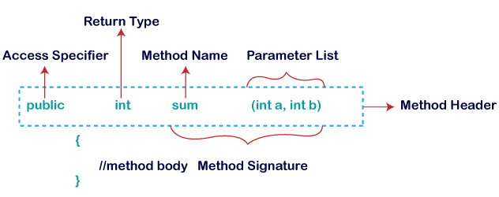
Declaring Methods
A method is a block of code or collection of statements or a set of code grouped together to perform a certain task or operation. It is used to achieve the reusability of code.
The method declaration provides information about method attributes, such as visibility, return-type, name, and arguments. It has six components that are known as method header
Syntax
return_type method_name(argument_list)
{
//statements;
}
Example:

Slide 111
Example Program:
class sample
{
public int addNumbers(int a, int b) // create a method
{
int sum = a + b; // return value return sum;
}
public static void main(String[] args)
{
int num1 = 25;
int num2 = 15; // create an object of Main
sample obj = new sample(); // calling method
int result = obj.addNumbers(num1, num2);
System.out.println("Sum is: " + result);
}
}
Output
Sum is: 40

Slide 112
I/O statements in Java
Java I/O (Input and Output) is used to process the input and produce the output. Java uses the concept of a stream to make I/O operations fast. The java.io package contains all the classes required for input and output operations.
Java Scanner Class
Java Scanner class allows the user to take input from the console. It belongs to java.util package. It is used to read the input of primitive types like int, double, long, short, float, and byte. It is the easiest way to read input in a Java program.
Syntax
Scanner object_name=new Scanner(System.in);
Example
Scanner s=new Scanner(System.in);

Slide 113
Methods of Java Scanner Class
Method Description
int nextInt() | It is used to scan the next token of the input as an integer.
float nextFloat() | It is used to scan the next token of the input as a float.
double nextDouble() | It is used to scan the next token of the input as a double.
byte nextByte() | It is used to scan the next token of the input as a byte.
String nextLine() | Advances this scanner past the current line.

Slide 114
Example
import java.util.Scanner;
class Main
{
public static void main(String[] args)
{
Scanner input = new Scanner(System.in); // creates an object of Scanner
System.out.print("Enter your name: ");
String name = input.nextLine(); // takes input from the keyboard
System.out.println("My name is " + name); // prints the name
input.close(); // closes the scanner
}
}
Output
Enter your name: Kelvin My name is Kelvin

Slide 115
Java BufferedReader Class
Java BufferedReader class is used to read the text from a character-based input stream. It can be used to read data line by line by readLine() method.
It makes the performance fast. It inherits Reader class.
Syntax
BufferedReader Object_name = new BufferedReader(new InputStreamReader(System.in));
Example
BufferedReader br=new BufferedReader(new InputStreamReader(System.in));

Slide 116
Example Program:
import java.io.*;
public class BufferedReaderExample
{
public static void main(String args[])throws Exception
{
FileReader fr=new FileReader("D:\\testout.txt");
BufferedReader br=new BufferedReader(fr);
int i;
while((i=br.read())!=-1)
{
System.out.print((char)i);
}
br.close();
fr.close();
}
}
Here, we are assuming that you have following data in "testout.txt" file:
Welcome to javaTpoint.
Output:
Welcome to javaTpoint.

Slide 117
Topics Covered 1.Constructors 2.this Keyword 3.Overloading Methods 4.Overloading Constructors, 5.Access Control 6.Usage of “static” 7.Usage of “final”

Slide 118
What is a constructor?
It is a member function which initializes a class.
A constructor has:
(i) the same name as the class itself
(ii) no return type Constructor is a special method of a Java class.
It has no return value of any type, not even void.
Constructor is automatically called when the object is created; no explicit call is required

Slide 119
Every class has a constructor, whether the programmer creates it or not.
this() and super() keyword must be the first statement in a constructor
Like methods, constructors can be overloaded.
Constructors can not be overridden.
One constructor can invoke another constructor of the same class using the keyword this().
Access specifiers/ modifiers can be applied before the constructor’s name to declare its scope in a class.
In Java, a constructor can never be static, final, abstract and Synchronized

Slide 120
Every time an object is created using the new() keyword, at least one constructor is called.
It calls a default constructor if there is no constructor available in the class.
In such cases, Java compiler provides a default constructor by default.
There are two types of constructors in Java:
● No-argument (Default) constructor
● Parameterized constructor.

Slide 121
Example1: Constructor
class Rectangle
{
int length; int width;
Rectangle(int x,int y)//constructor method
{
length=x; width=y;
}
int rectArea()
{
return(length*width);
}
}

Slide 122
class RectangleArea
{
public static void main (String args[])
{
Rectangle rect1=new Rectangle(15,10);//calling constructor
int area1=rect1.rectArea();
System.out.println(“Area =” +area1);
}
}
Output:
Area=150

Slide 123
Example 2
class Complex
{
int real;
int imag;
Complex() //No argument or default constructor
{
real=0;
imag=0;
}
Complex(int r,int i) //Parameterized constructor
{
real=r;

Slide 124
imag=i;
}
public static void main(String[] args)
{
Complex c1=new Complex(); //invoked No argument constructor
System.out.println(c1.real+"+"+c1.imag+"i"); //0+0i
Complex c2=new Complex(2,3); //invoked parameterized constructor
System.out.println(c2.real+"+"+c2.imag+"i"); //2+3i
}
}

Slide 125
Example3
class complex
{
double real,imag;
complex() //simple or default constructor
{
real=0.0;
imag=0.0;
}
complex(double x,double y) //parameterized constructor
{
real=x;
imag=y;
}

Slide 126
complex add(complex a) //copy constructor
{
complex n=new complex();
n.real=this.real+a.real;
n.imag=this.imag+a.imag;
return n;
}
void display()
{
System.out.println(“The result is”+real+”+i”+imag);
}
}

Slide 127
class comclass
{
public static void main(String args[])
{
complex c1=new complex(10,20); complex c2=new complex(10,20);
complex c1=new complex(); c3=c1.add(c2);
c3.display();
}
}
Output
The result is 20.0+i40.0

Slide 128
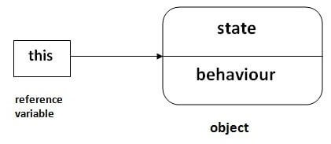
This Keyword
this: to refer current class instance variable
In Java, this is a reference variable that refers to the current object.
The “this” keyword can be used to refer current class instance variable.
If there is ambiguity between the instance variables and parameters.
“this” Keyword resolves problem of ambiguity.

Slide 129
Usage of Java this keyword
this can be used to refer current class instance variable.
this can be used to invoke the current class method (implicitly)
this() can be used to invoke the current class constructor.
this can be passed as an argument in the method call.
this can be passed as an argument in the constructor call.
this can be used to return the current class instance from the method.

Slide 130
Example
class Student
{
int rollno; String name; float fee;
Student(int rollno,String name,float fee)
{
this.rollno=rollno;
this.name=name;
this.fee=fee;
}
void display()
{
System.out.println(rollno+" "+name+" "+fee);
}
}

Slide 131
class TestThis2
{
public static void main(String args[])
{
Student s1=new Student(111,"ankit",5000f);
Student s2=new Student(112,"sumit",6000f);
s1.display();
s2.display();
}
}
Output:
111 ankit 5000.0
112 sumit 6000.0

Slide 132
Method Overloading in Java
If a class has multiple methods having the same name but different parameters, it is known as Method Overloading.
Advantage of method overloading
Method overloading increases the readability of the program.
Different ways to overload the method
There are two ways to overload the method in java
By changing the number of arguments
By changing the data type

Slide 133
Method Overloading: changing no. of arguments
In this example, we have created two methods, first, add() method performs the addition of two numbers and second add() method performs the addition of three numbers.
Example
class Adder
{
int add(int a,int b)
{
return a+b;
}

Slide 134
int add(int a,int b,int c)
{
return a+b+c;
}
}
class TestOverloading1
{
public static void main(String[] args)
{
Adder a=new Adder();
System.out.println(a.add(11,11)); System.out.println(a.add(11,11,11));
}
}
Output:
22
33

Slide 135
Method Overloading: changing data type of arguments
In this example, we have created two methods that differ in data type. The first add method receives two integer arguments and the second add method receives two double arguments.
Example
class Adder
{
int add(int a, int b)
{
return a+b;
}
double add(double a, double b)
{

Slide 136
return a+b;
}
}
class TestOverloading
{
public static void main(String[] args)
{
Adder a=new Adder();
System.out.println(a.add(11,11)); System.out.println(a.add(12.3,12.6));
}
}
Output:
22
24.9

Slide 137
Constructor Overloading
Creating two or more constructors with different parameters is called constructor overloading
Example
class Main
{
String language;
Main() // constructor with no parameter
{
language = "Java";
}
Main(String lang) // constructor with a single parameter
{

Slide 138
language = lang;
}
public void getName()
{
System.out.println("Programming Langauage: " + language);
}
public static void main(String[] args)
{
Main obj1 = new Main(); // call constructor with no parameter
Main obj2 = new Main("Python"); // call constructor with a single parameter
obj1.getName(); obj2.getName();
}
}
Output
Programming Language: Java Programming
Language: Python

Slide 139
Access Controls / Access Specifier / Access Modifier
Java provides four Access Modifiers to set access levels for classes, variables, methods, and constructors.
The four access levels are
default: The access level of a default modifier is only within the package. It cannot be accessed from outside the package No modifiers are needed.
private: The access level of a private modifier is only within the class. It cannot be accessed from outside the class.
public: The access level of a public modifier is everywhere. It can be accessed from within the class, outside the class, within the package and outside the package.
protected: The access level of a protected modifier is within the package and outside the package through child class. If you do not make the child class, it cannot be accessed from outside the package

Slide 140
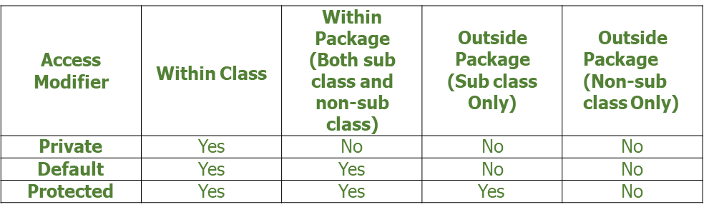


Slide 141
Non access modifiers
Java has seven Non-Access Modifiers. Non-Access Modifiers are used with classes, methods, variables, constructors. Non-Access Modifiers are used to provide information to JVM.
Seven Non-Access Modifiers are
Static: The static keyword in Java is used for memory management mainly. We can apply static keyword with variables, methods, blocks and nested classes. The static keyword belongs to the class than an instance of the class
Final: The final keyword in java is used to restrict the user. The java final keyword can be used in many contexts. Final can be variable, method and class

Slide 142
.
Abstract: The abstract keyword is used to achieve abstraction in Java. It is a non-access modifier which is used to create abstract class and method. The role of an abstract class is to contain abstract methods
Synchronized: Java programming language provides a very handy way of creating threads and synchronizing their task by using synchronized blocks to keep shared resources.
Transient: Java transient keyword is used in serialization. If you define any data member as transient, it will not be serialized.
Volatile: Volatile keyword is used to modify the value of a variable (either primitive type or objects) by different threads. It is also used to make classes thread safe.
Native: The native keyword is applied to a method to indicate that the method is implemented in native code using JNI (Java Native Interface). Native is a modifier applicable only for methods and cannot apply it anywhere else. The methods which are implemented in C, C++ are called as native methods or foreign

Slide 143
Java Static Keyword
The static keyword in Java is used for memory management mainly. We can apply static keywords with variables, methods, blocks, and nested classes. The static keyword belongs to the class than an instance of the class.
The static can be:
Variable (also known as a class variable)
Method (also known as a class method)

Slide 144
Java static variable
If you declare any variable as static, it is known as a static variable.
The static variable can be used to refer to the common property of all objects (which is not unique for each object), for example, the company name of employees, the college name of students, etc.
The static variable gets memory only once in the class area at the time of class loading.

Slide 145
Advantages of static variable
It makes your program memory efficient (i.e., it saves memory).
Program of a counter by static variable.
The static variable will get the memory only once, if an object changes the value of the static variable, it will retain its value.

Slide 146
//Java Program to illustrate the use of static variables which is shared with all objects.
class Counter2
{
static int count=0;//will get memory only once and retain its value Counter2(){
count++;//incrementing the value of the static variable
System.out.println(count);
}
public static void main(String args[])
{
//creating objects
Counter2 c1=new Counter2();
Counter2 c2=new Counter2();
Counter2 c3=new Counter2();
}
}
Output
1
2
3

Slide 147
Java static method
If you apply a static keyword with any method, it is known as a static method.
A static method belongs to the class rather than the object of a class.
A static method can be invoked without the need for creating an instance of a class.
A static method can access static data members and can change their value of it.

Slide 148
Example of static method
//Java Program to get the cube of a given number using the static method
class Calculate
{
static int cube(int x)
{
return x*x*x;
}
public static void main(String args[])
{
int result=Calculate.cube(5); System.out.println(result);
}
}
Output
125

Slide 149
Final Keyword in Java
The final keyword in java is used to restrict the user. The java final keyword can be used in many contexts. The Final can be:
variable
method
class
The final keyword can be applied to the variables, a final variable that have no value is called a blank final variable or uninitialized final variable.
It can be initialized in the constructor only. The blank final variable can be static also which will be initialized in the static block only.

Slide 150
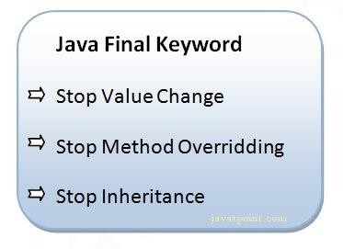
Java final variable
If you make any variable final, you cannot change the value of a final variable (It will be constant).

Slide 151
Example of final variable
There is a final variable AGE, we are going to change the value of this variable, but it cannot be changed because the final variable once assigned a value can never be changed.
Example
class Main
{
public static void main(String[] args)
{
final int AGE = 32; // create a final variable
AGE = 45; // try to change the final variable
System.out.println("Age: " + AGE);
}
}
Output:
cannot assign a value to final variable AGE
AGE = 45;

Slide 152
Java final method
If you make any method final, you cannot override it.
Example
class FinalDemo
{
public final void display() // create a final method
{
System.out.println("This is a final method.");
}
}
class Main extends FinalDemo
{

Slide 153
public final void display() // try to override final method
{
System.out.println("The final method is overridden.");
}
public static void main(String[] args)
{
Main obj = new Main();
obj.display();
}
}

Slide 154
In the above example, we have created a final method named display() inside the FinalDemo class.
Here, the Main class inherits the FinalDemo class.
We have tried to override the final method in the Main class. When we run the program, we will get a compilation error with the following message.
Output
display() in Main cannot override display() in FinalDemo public final void display() {
^
overridden method is final

